Slide 1
ZOOKEEPER, OOZIE
AURORA, AKKA

Slide 2
Zookeeper
Why Zookeeper
What is Zookeeper
Basic Architecture
How it works
Who uses the Zookeeper

Slide 3
Distributed System
Definition : System consists of multiple computers that communicate through a computer network and interact with each other to achieve a common goal.
Fallacies of Distributed System like Reliable Network, Zero Latency, Infinite Bandwidth, Secure Network,
One Administrator etc.
Coordination of Distributed System :
Group membership
Locking
Publisher/Subscriber
Leader Election
Synchronization
This Coordination is very hard to get, To achieve this coordination we use ZK.

Slide 4
What is Zookeeper
High-performance coordination service for distributed applications.
Exposes common services in simple interface:
Naming
Configuration management
Locks & synchronization
Group services
Build your own, if needed.

Slide 5
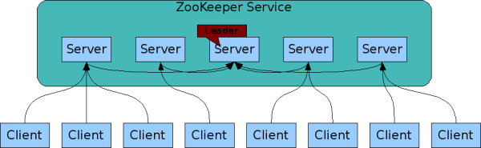
Zookeeper Service
Zookeeper Service is replicated over a set of machines
All machines store a copy of the data (in memory)‏
A leader is elected on service startup
Clients only connect to a single Zookeeper server & maintains a TCP connection.
Client can read from any Zookeeper server, writes go through the leader & needs majority consensus

Slide 6
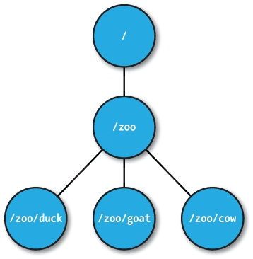
Zookeeper Data Model
Hierarchal name space and each node in the NS is ZNode.
Every ZNode contains data (given as byte[]) and can have children.
ZNode paths:
slash-separated
Maintain a stat structure with version numbers for data changes, timestamps.
Version numbers increases with changes
Data is read and written in its entirety
Types of ZNode
Persistent Nodes
Ephemeral Nodes
Sequence Nodes (Unique Naming)

Slide 7
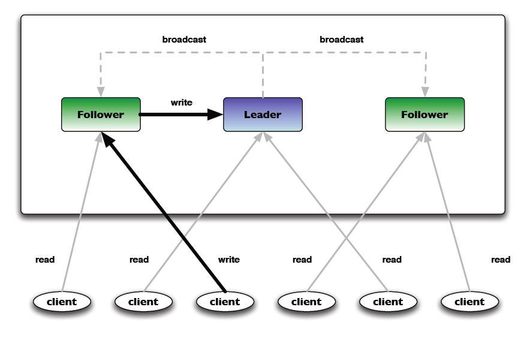
ZNode Operation
Read, example : getChildren, getData
Write, example : create Znode, delete Znode, setData
Read requests are processed locally at the ZooKeeper server to which the client is currently connected
Write requests are forwarded to the leader and go through majority consensus before a response is generated.

Slide 8
Consistency Guarantees
Sequential Consistency: Updates are applied in order
Atomicity: Updates either succeed or fail
Single System Image: A client sees the same view of the service regardless of the ZK server it connects to.
Reliability: Updates persists once applied, till overwritten by some clients.
Timeliness: The clients’ view of the system is guaranteed to be up-to-date within a certain time bound. (Eventual Consistency)

Slide 9
ZNode Watches
Clients can set watches on Znodes for example:
NodeChildrenChanged
NodeCreated
NodeDataChanged
NodeDeleted
Watches are one time triggers and always ordered.
Client sees watched event before new ZNode data.

Slide 10
Language Bindings and who uses ZK
Zookeeper ships client libraries in:
Java
C
Perl
Python
Community contributed client bindings available for Scala, C#, Node.js, Ruby, Erlang, Go, Haskell.
Companies:
Yahoo!
Zynga
Rackspace
LinkedIn
Netflix
Twitter

Slide 11
NEXT >>

Slide 12

What is OOZIE ?
Why use OOZIE ?
OOZIE Architecture
How Oozie works ?

Slide 13
What is OOZIE ?
Provides operation services for Hadoop Cluster such as :-
Work Flow scheduler for Hadoop
Manages Hadoop Jobs
Supports Hadoop jobs for Apache Map Reduce, Apache Pig, Apache Hive, Apache Sqoop
Type of Oozie Jobs
Oozie Workflow jobs – Directed Acyclical Graphs(DAG’s)
Specify sequence of action to execute
Oozie Coordinators – Recurrent Oozie Workflow jobs
Triggered by time and data availability

Slide 14
Why use Oozie ?
Workflow scheduled based on data availability or frequency
Monitoring capabilities, automatic retry
Allows you to design task work flows
Extensible and pluggable architecture to allow arbitrary grid programming paradigms

Slide 15
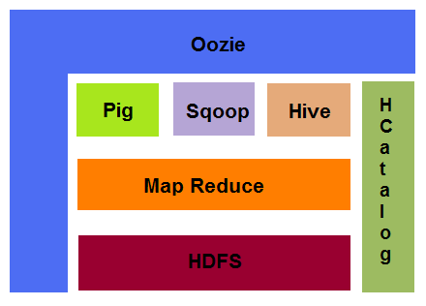
Oozie Architecture

Slide 16
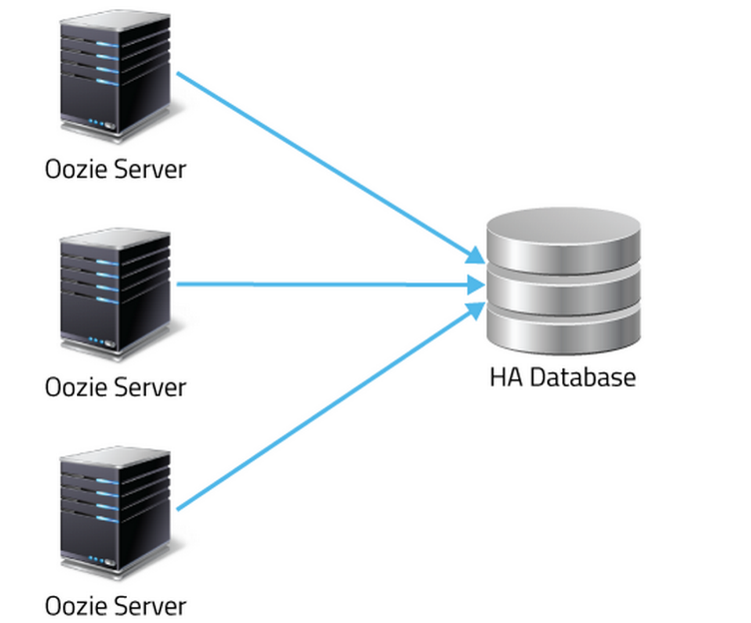
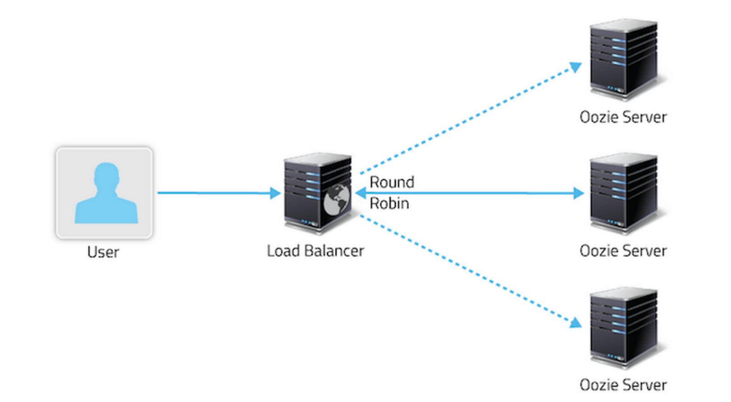
Oozie Architecture
--Based on concept of hot hot HA
HA - (sys with no-planned downtime)
-- Oozie was designed to be stateless
-- -- Nothing lost when Oozie server goes down
-- -- Jobs continue to run when server is up again
-- --Oozie maintains multiple locks to prevent
same jobs to process multiple times.
-

Slide 17
How Oozie works ?
Collection of actions arranged in a Directed Acyclic Graph
Control need to define job chronology, setting rules for workflows
Triggers workflows but Hadoop executes them allowing to leverage using other features like balance load and failure handling
Detects completion of tasks using callback and polling

Slide 18
NEXT >>

Slide 19
AKKA
Simpler
Concurrency
Scalability
Fault-tolerance

Slide 20
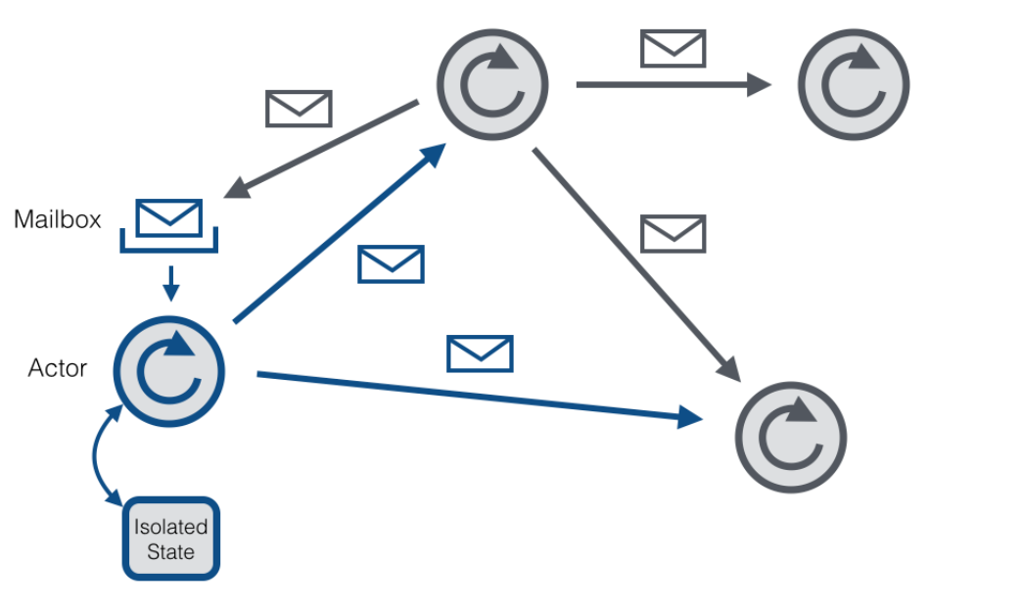
Akka and the Actor Model
Single Thread
Asynchronous messages

Slide 21
Akka Actor
Sequential by nature
Never call blocking calls
Threadsafe
Fault-tolerance
E
Event Driven Thread
Actor
Message Box
Behavior
State

Slide 22
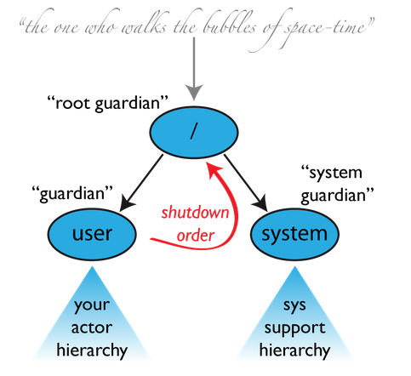
Actor System
Container of Actor
Provides shared services such as scheduling, configuration and logging
Thread-pool
Local Communication through shared memory.
Remote Communication through network Stack.
Hierarchy of Actors

Slide 23
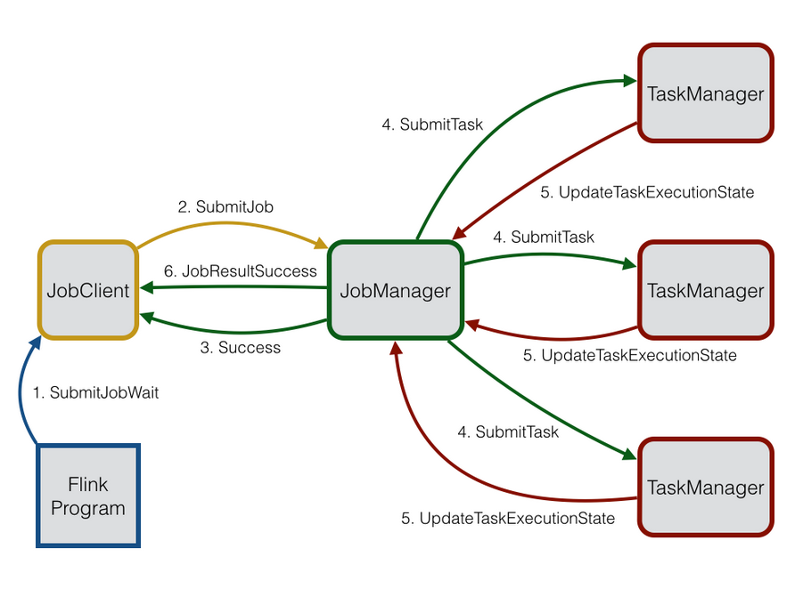
Actors in Flink

Slide 24
Failure Detection
Akka Deathwatch mechanism
JobManager watches all registered TaskManagers and the TaskManagers watch the JobManager
akka.watch.heartbeat.interval
akka.watch.heartbeat.pause
akka.watch.threshold

Slide 25
Actors
case object Tick
class Counter extends Actor {
var counter = 0
def receive = {
case Tick =>
counter += 1
println(counter)
}
}
val counter = actorOf[Counter].start()

Slide 26
Actors Send and Receive Messages
To Send and Message:
Counter ! Tick (fire-forget)
To Reply back
def receive = {
case Tick = counter += 1
case Current => self.reply(counter)
}

Slide 27
NEXT >>

Slide 28

What is AURORA ?
Why use AURORA ?
AURORA Architecture
How AURORA works ?

Slide 29
What is AURORA ?
A Mesos framework for long running services and cron jobs
Runs application and services across shared pool of machines and keeps them running, forever.
Consist of task templates and instructions for creating near identical replicas of the task.

Slide 30
Key Features
Rolling updates with automatic rollback
Resource Quota and Multi User Support
Provides sophisticated DSL to define services
Service Registration
Health Checking
Instant provisioning

Slide 31
Requirements to Run Aurora
Need to install Vagrant
Install Virtual Box
Cloning Aurora
Process :-
Need to start vagrant using vagrant up
5 virtual machines launched
Devtools
Zookeeper
Mesos-master
Mesos-slave
Aurora scheduler

Slide 32
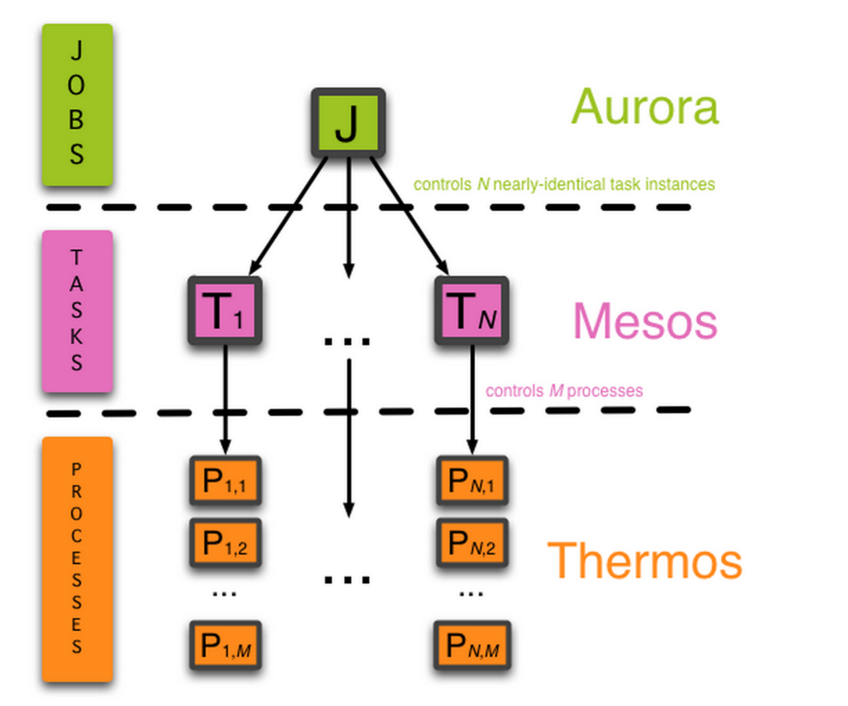
Aurora Architecture
Aurora manages jobs made of tasks
Mesos manages tasks made of processes
Thermos manages processes
Configuration file defining all of the above jobs, tasks and processes

Slide 33
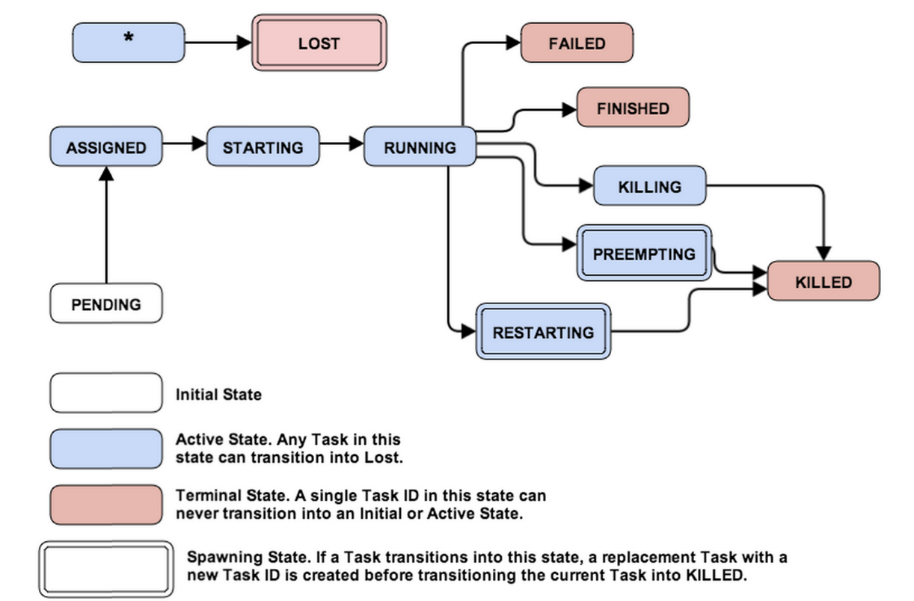
How it works
Aurora reads a configuration file and finds the job following action is executed:-
Evaluates the job definition
Splits the job into constituent task
Send those task to the scheduler
The scheduler put those tasks into the pending state, starting each task life cycle

Slide 34
Language Bindings and who uses Aurora
Apache Aurora client libraries in:
C++
Java
Python
Companies:
Twitter
Boxever
Foursquare
TellApart
Sabre Labs
Oscar Health

Slide 35
References
http://www.typesafe.com/activator/template/spark-streaming-scala-akka
https://cwiki.apache.org/confluence/display/FLINK/Akka+and+Actors
https://github.com/jaceklaskowski/spark-activator#master
http://aurora.apache.org/documentation/latest/
http://hortonworks.com/hadoop/oozie/
http://oozie.apache.org/
http://allthingshadoop.com/2013/12/16/getting-started-with-apache-mesos-and-apache-aurora-using-vagrant/
https://dzone.com/articles/getting-started-apache-mesos
https://github.com/apache/oozie

